Slide 1
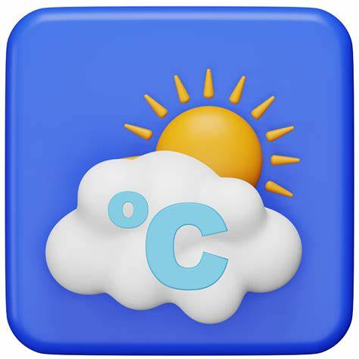
Weather App Using Java
This presentation explores building a weather app using Java. We cover key features like forecasts and location services. The app targets Java developers, students, and weather enthusiasts seeking real-time data.
Group Members
Roll No
Name
84
Divya Jitendra Sutar
98
Shreeya Amit Kalebere

Slide 2

Introduction
Weather is an essential factor in our daily decision-making, influencing activities such as commuting, traveling,
farming, and event planning. With the rise in unpredictable weather patterns and the increasing demand for
real-time updates, having a simple and accessible tool to check the current weather hasbecome important for
everyone.
This mini-project aims to develop a very simple weather application using core Java concepts and a Graphical
User Interface (GUI) built with Java Swing. The application allows users to enter a city name and view the
current weather information, such as temperature, humidity, and general conditions, in an easy-to-read
format. By integrating with a public weather API and using basic Java networking and JSON parsing, the app
demonstrates how fundamental programming concepts can be applied to solve real-world problems in a
lightweight and user-friendly manner.

Slide 3
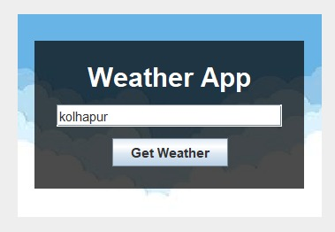
Project Objectives
To build a simple GUI-based weather app using core Java.
To fetch real-time weather data using a public API.
To display weather details like temperature, humidity, and condition.
To practice Java concepts like Swing, event handling, and API integration.

Slide 4




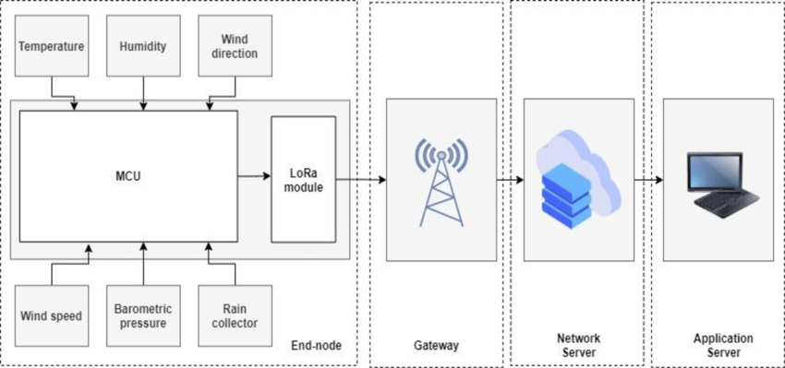
System Architecture
HTTP Requests
JSON Parsing
UI Display
Live Demo
Code examples for fetching weather data
Extract needed information efficiently
Visualize weather using Java Swing or JavaFX
Run and test basic weather app functionality

Slide 5




Working Of The System
1.User Input via GUI: The user opens the app and enters the name of a city in the input field, then clicks the "Get Weather" button.
2.API Request and Response: The app sends a request to a public weather API (like OpenWeatherMap) using the entered city name and receives a JSON response with current weather data.
1
2
4.Display Results: The extracted weather details are displayed on the GUI in a readable format. If an error occurs (invalid city, no internet), a message is shown to the user.
3.Data Processing: The app parses the JSON data to extract relevant information such as temperature, weather condition, humidity, and wind speed.
4
3

Slide 6

Java Concepts Utilized
Java – Core programming language for application logic
Java Swing– For creating Graphical User Interface
Java Networking– To send HTTP request to Weather API
JDK(Java Development Kit)– To Compile and Run java Application
IDE(IntelliJ IDEA)– For Writing and Debugging code

